Slide 1
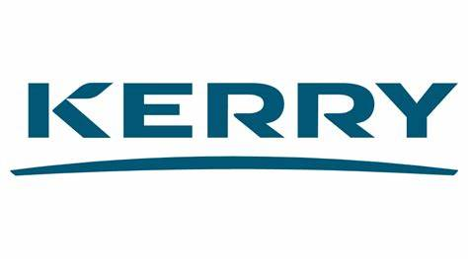
– “with technology for betterment of People, Society and Environment.”
TRANSFORMING HORIZONS

Slide 2





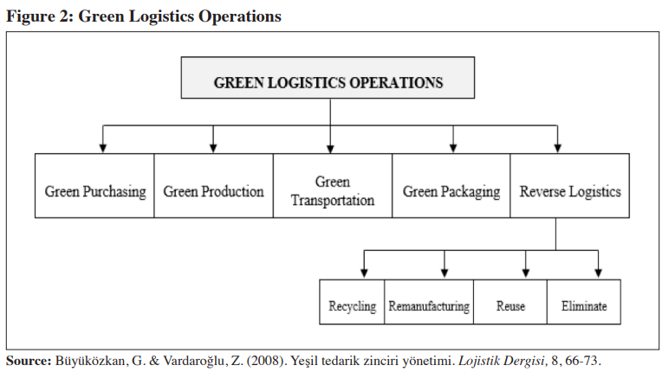


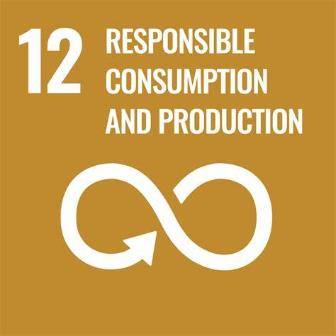
TRANSFORMING HORIZONS – “with technology for betterment of Society, People and Environment.”
For people
Clean Label Solutions :
2) Assists in the transparency in logistics of a supply chain by geofencing, monitoring delays, providing geolocation and radio frequency identification (RFID) technology.
B. Transport Fleet and Route Optimization
Innovative Sustainable Nutrition
Clean Label Solutions
For the people
Investing in R&D along with reformulation of existing products.
Partnership with retailers
Consumer Education
Ensure responsible sourcing
For society
1) Using alternative fuels such as CNG or electrification of distribution vehicles.
2) Using optimization algorithms and to create the shortest route possible to avoid traffic congestion.
3) Optimizes capacity of delivery fleet to reduce travel times.
4) Forecasts estimated travel time.
Diversity, Inclusiveness and Belonging
Unconscious Bias Training Sessions
Helps in creating sense of empathy towards every person.
Encourage interactions among people from different groups.
Increase cultural competency.
The future of 3-D printed nutritional supplements and oral capsules – an approach towards pharma innovation:
2) Diversity, Equity and Inclusion (DEI) Metrics
Satisfies Kerry’s commitment towards Climate by reducing carbon emissions.
And,
Contributes to SDG-13 and SDG-7
Customized taste, flavours and textures to enhance consumer experience.
Rapid prototyping to foster innovation.
Attain unique shapes and designs making it appealing to children
Precise control over dosage.
Customized capsule coatings for controlled release, taste masking and improved stability or shelf life.
Simplifying supply chain by smoothing on-demand production hence less inventory and major cost savings and customer satisfaction. HENCE, a WIN-WIN situation.
Reducing waste generated as compared to traditional manufacturing.
Retention rate and employee turnover rate based on gender, race or religion.
Employee advancement/proportion rate
Equal pay
Satisfies Kerry’s commitment towards Society.
And,
Contributes to SDG-10
Adopting AI for Green Packaging
Packaging Design Optimization – able to analyze product dimensions and recommend the most efficient packaging design to reduce material usage and transportation costs.
Real-time Quality Control - monitor the quality of packaging in real-time and identify any defects that may lead to waste or environmental impact.
Eco-Friendly Material Selection - AI can help Kerry choose eco-friendly materials for packaging by analyzing and comparing the environmental impact of different packaging materials .
SMART Packaging - AI can be used to create smart packaging solutions that can detect when food is going bad or when it has been contaminated.
Recycling Optimization -AI can be used to optimize the recycling process by identifying recyclable materials and reduce waste.
For Environment
Satisfies Kerry’s commitment towards sustainable nutrition solutions and circularity.
And,
Contributes to SDG-3, SDG-9, SDG-12
Industry 4.0 technologies integrated with Green Logistics framework
Challenges for company in implementing 3-D printing :
Excessive cost of adoption
Complexity in operation
Production/Preparation time
Regulation and Government interventions
Cost-Benefit Analysis
IoT integrated logistics for green transportation –
Satisfies Kerry’s commitment towards Circularity.
And,
Contributes to SDG-9, SDG-12 and SDG-13
Smart Containers –
Innovation based on IoT (Internet of Things) technology.

Slide 3
Responsible Sourcing and food security
Engaging closely with suppliers to foster collaboration and encourage continuous improvement in sustainability performance.
Kerry’s other Supply chain Challenges.
Scenario-based Planning integrated with Agile supply chain framework for uncertainties.
Scenario-1
Demand for natural foods experiences a sudden surge in popularity, driven by a major health crisis.
Planning Strategy
Kerry group could quickly pivot to meet the sudden surge in demand by partnering with local farmers or suppliers to increase their supply of natural ingredients by ramping up production of relevant products.
Scenario-2
Increased demand for sustainable and environmental friendly products driven by growing consumer awareness or major environmental crisis.
Planning Strategy
Kerry could develop new product lines such as eco-friendly packaging or partnering with new suppliers to source more sustainable ingredients or consider rebranding existing products to emphasize their environmentally-friendly features.
Geopolitical risks
Inflationary Pressures
Changing consumer preferences
Volatility in commodity prices
SUPPLIER RISK MITIGATION STRATEGY-
Performing Corporate Due Diligence in the supplier selection processes
Changes to Supplier Selection Process:
1) Sustainability pre-qualification Questionnaire
2)Environmental certifications - ISO 14000
3) Conducting Supplier Assessments based on labour practices, social responsibility, quality standards, surge capacity availability along with financial checks, on-site audits.
4) Payment terms – ‘Letter of Credit’ while working with high risk/new supplier.
Scenario-based Planning
Predictive Analytics
Criteria of compliance for suppliers
Responsible Business Practices (BHP, 2022)
Environmental Responsibility (BHP, 2022)
Handling hazardous materials and waste (BHP, 2022)
Community Interaction (BHP, 2022)
Prohibition of child labour (BHP, 2022)
Prohibition of forced labour and slavery (BHP, 2022)
Non-discrimination and diversity(BHP, 2022)
Right to health and safety in the workplace (BHP, 2022)
Wages, Penalties and working hours (BHP, 2022)
Human Trafficking (BHP, 2022)
Corruptions, Bribery and Extortion (BHP, 2022)
Scenario - Geopolitical risk
Mitigation - Kerry sources a significant amount of its raw materials from China. However, due to rising tensions between China and the US, there is a possibility of increased tariffs and trade barriers that could disrupt the supply chain and increase costs .Kerry could consider factors such as the impact on raw material sourcing, manufacturing, and logistics costs, as well as potential changes in consumer behavior and demand. Kerry could develop strategies to mitigate risks and take advantage of opportunities. For example, they could explore alternative sourcing options for raw materials or invest in developing new supply chain partnerships. They could also examine ways to increase efficiency and reduce costs in their operations.
Same can be done with Inflationary pressures and changing consumer preferences which is a part of geopolitical risks.
Agile Supply chain
Redundancy
Flexible Manufacturing
Faster response time
Modular Manufacturing Processes
Innovation – it will allow Kerry to experiment with new products or processes to bring out new flavours or taste without incurring significant costs.
Sustainability – it will enable Kerry to use modular units that are designed to be energy efficient and reduce waste hence reducing the carbon footprint.
Flexibility – it will allow Kerry to easily adapt to market changes and changing consumer preferences by quickly ramping up production by adding more modules.
Faster time to market - it will facilitate in bringing new products to market more quickly by simply adding new modules to existing manufacturing process.
Improved Quality – it will allow Kerry to isolate and address specific issues in manufacturing processes and improve quality.
Lower Inventory Level - which could be done by production of smaller customized batches in response to changing demand.
Risk - Volatile commodity prices
Mitigation- Kerry uses a significant amount of cocoa in its chocolate products. The price of cocoa can be highly volatile, and fluctuations in price can significantly impact the company's profitability. Kerry can use predictive analytics which takes in consideration weather conditions, geopolitical factors etc. to forecast the price of cocoa and develop strategies to manage their exposure. Predictive Analysis can collect historical data on cocoa prices and use machine learning algorithms to identify patterns and forecast future price movements. For example, if the forecast indicates that cocoa prices are likely to increase, Kerry could consider developing alternative products that use less cocoa or using cocoa substitutes to reduce the amount of cocoa used in their products.

Slide 4

T H A N K
Y O U
A N D
H A V E
A N
I N N O V A T I VE
D A Y

